Slide 1
Objectives
By the end of this session you will be able to write basic Control Plans

Slide 2
Project Control Plans
Set up the following controls to bring the project to a successful conclusion.
Scope Management
Risk Management
Quality Management
Issue Management
Communication Management
Library

Slide 3
Scope Change Control
Ensures that any changes to the project’s scope will help the project achieve its MOV.
Keeps the “triple constraint” in balance.
i.e., an increase in scope will require an increase in the project’s schedule and budget.
Text Chap. 5
Scope
Schedule
Budget

Slide 4
Scope Change Control
Mitigates:
Scope Grope – i.e., scope poorly defined
Scope Creep – i.e., increasing featurism
Scope Leap – i.e., drastic change in project direction or the project’s MOV
Tools:
Scope Change Request Form
Scope Change Request Log

Slide 5
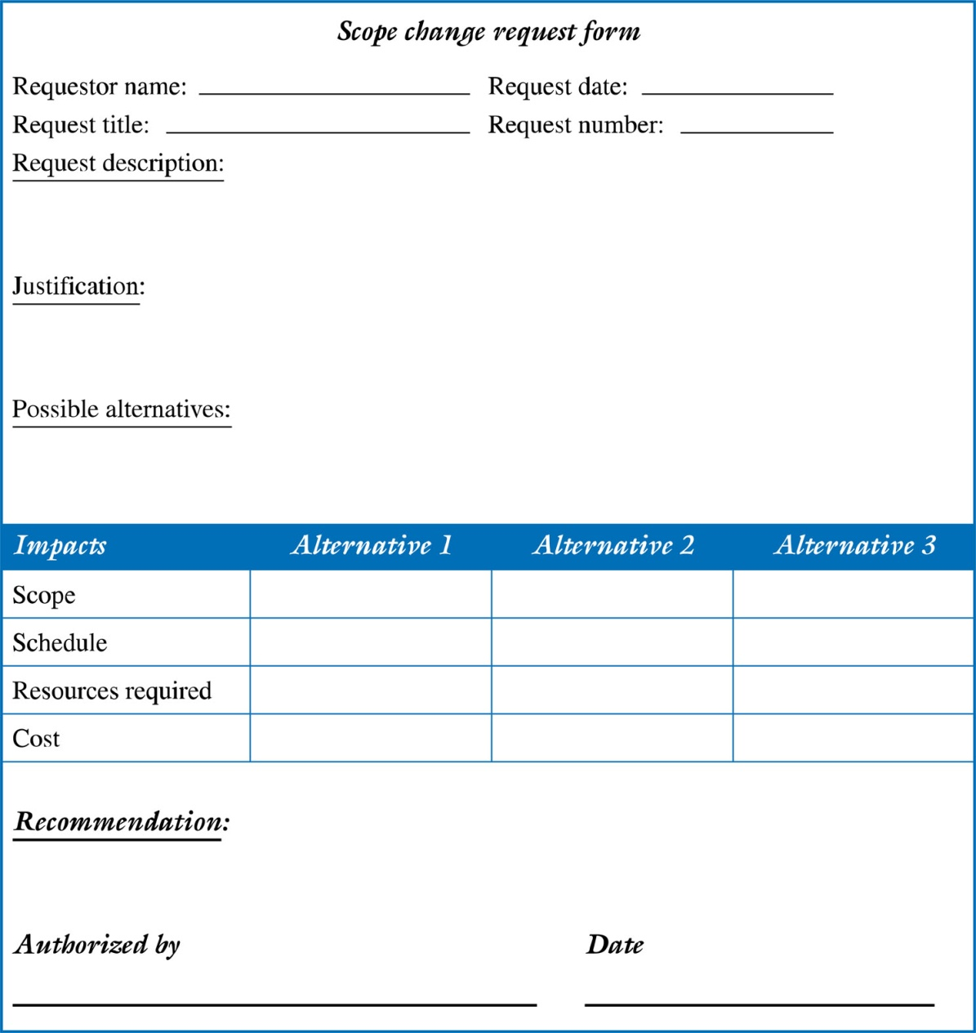
Example of a Scope Change Request Form

Slide 6
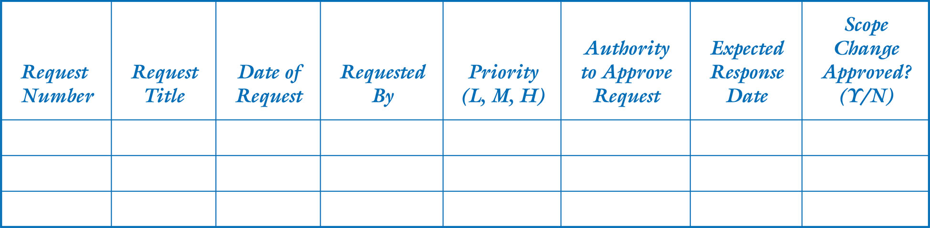
Example of a Scope Change Request Log

Slide 7
Benefits of Scope Control
Keeps the project manager in control of the project.
Gives the project manager the authority to manage and control the project’s schedule and budget. Otherwise she or he may ‘feel” pressured by the client or upper management to accept scope changes
Allows the project team to stay focused and on track
Do not have to perform unnecessary work

Slide 8
Risk Management
Text = Chapter 8.

Slide 9
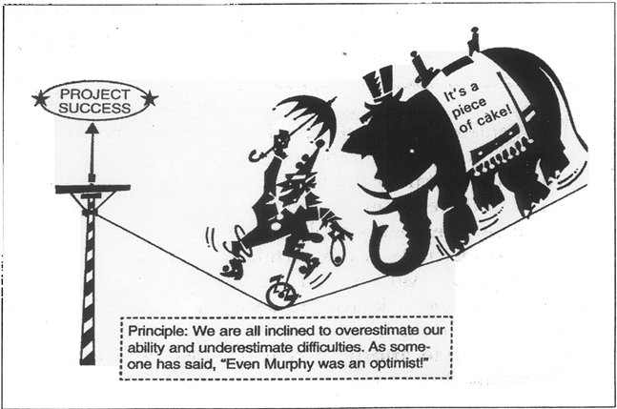
Perhaps the most famous “law” of all is Murphy’s Law, which is usually stated as “Whatever can go wrong will!”
From The Project Manager’s Desk Reference – James P. Lewis

Slide 10
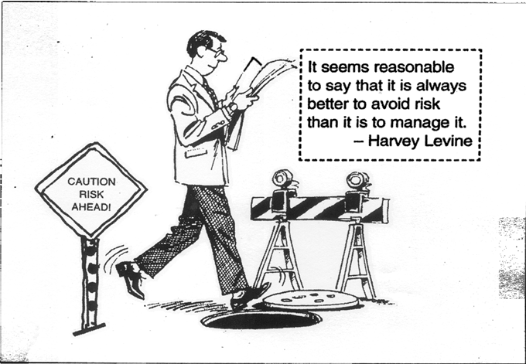
Avoid Risks – “…through better planning, not by avoiding a good opportunity.”
From The Project Manager’s Desk Reference – James P. Lewis

Slide 11
What is Risk?
Risks are events that are beyond the project manager’s control
If not managed, risks can steer the course of activity away from the desired outcome
Risks are worth anticipating and having mitigation plans
Risk Management is the process of anticipating hurdles that might occur and putting in place a plan to mitigate the effect of these hurdles when they occur.

Slide 12
Software Risk Management
What is Risk Management?
Why Risk Management?

Slide 13
Three Components of Risk
Risk Impact (I)
Risk Event Probability (P)
An estimate of the probability that a given risk event will occur
Severity of Risk Event (also called Risk Event Value) (R)
Relationship between the components (R=P*I)

Slide 14
Project Risk Management Processes

Slide 15
Risk Identification
Different ways of identifying risks
Risk identification workshops – include appropriate subject matter experts, stakeholders and outside experts
Examining organizational history
Using checklists and lessons learned from past projects
Sources of risk – internal and external
Causes and effects of risk

Slide 16
Risk Evaluation
Determine the following
Probability of the risk occurring
Impact of the risk
Risk Event Value or Risk Severity
Rank the risks based on the Risk Event Value
Identify the risks that will be managed

Slide 17
Risk Probability
Probability is generally determined as
High – Likely to significantly disrupt the schedule, increase cost and / or degrade performance
Moderate – Has the potential to disrupt the schedule, increase cost and / or degrade performance
Low – Has little potential to disrupt the schedule, increase cost and / or degrade performance

Slide 18
Risk Impact
Impact is also determined as
High
Moderate
Low

Slide 19
Risk Severity
Risk Severity or Risk Event Value is the product of Risk Probability and Risk Impact
Impact
Low
Moderate
High
High
Moderate
High
Very High
Probability
Moderate
Low
High
High
Risk Severity
Low
Low
Moderate
Moderate
Risk Severity

Slide 20
Risk Mitigation
Risk mitigation is a process of minimizing and/or avoiding the impact of risks
It is a set of planned actions to either prevent the risk from occurring or to minimize its impact, if it occurs
The risks that have a high expected monetary value are considered first and mitigation plans worked out

Slide 21
Risk Monitoring
Risk monitoring is the process of continuously keeping track of the project environment and predicting the occurrence of risks
Based on some indications, mitigation actions may get triggered
Determining what indicators trigger what risks is a matter of experience

Slide 22
Risk Management Example
Risk | Chance | Impact | Assumptions / PRECAUTIONS | Contigency
Client changes requirements | High | Changes to budget and timeline | Change Control procedures are in place | Carry out in-depth requirements analysis
Client is unsure of user interface | Medium | Changes to budget and timeline | Client will be readily available to provide feedback
Electrician unable to complete cabling | Low

Slide 23
Risk Management
RISK
CHANCE
IMPACT
ASSUMPTIONS / PRECAUTIONS
CONTINGENCY

Slide 24
Some words of wisdom ….
Move away from the mode of “Reactive Actions” and transform yourself to operate in the mode of “Pro-active Prevention”.

Slide 25
Issue Management
(Not in text.)

Slide 26
Issue and Conflict Management
Issues arise essentially due to conflicts. Therefore conflict management is the key to managing issues.
Contemporary view of conflict management
Inevitable between human beings
Often beneficial - produces important results, such as new ideas, better alternatives, and motivation to work harder and more collaboratively
Natural result of change
Can and should be managed
Neither good nor bad, but can have positive and negative results for the organization
Project Manager must carefully select the method of managing conflict, appropriate in the organization, so that an atmosphere conducive to constructive results is developed.
Research suggests that task-related conflict often improves team performance, but emotional conflict often depresses team performance.

Slide 27
Issue and Conflict Management
Top Tips:
Confront the conflict head on.
Be sincere and be genuinely interested in resolving the conflict.
Listen to all the conflicting parties without any bias.
Identify areas of agreement.
Discuss areas of disagreements with an open mind and reach a Win-Win situation.
High
Integrating
Obliging
Concern for Others
Low
Dominating
Avoiding
High
Low
Concern for Self

Slide 28
Issue and Conflict Management
Confrontation: directly face a conflict using a problem-solving approach
Compromise: use a give-and-take approach
Smoothing: de-emphasize areas of difference and emphasize areas of agreement
Forcing: the win-lose approach
Withdrawal: retreat or withdraw from an actual or potential disagreement
Collaborating: decision makers incorporate different viewpoints and insights to develop consensus and commitment

Slide 29
ISSUE MANAGEMENT
ISSUE / SITUATION
IMPACT
SOLUTIONS
RESPONSIBILITY

Slide 30
ISSUE MANAGEMENT
ISSUE / SITUATION
IMPACT
SOLUTIONS
RESPONSIBILITY
Information gathering by email
Slow process, might miss important facts
Ask more questions, and recheck everything
PM and Client Contact
Client staff not yet hired
Client has low level of IT skills.
Client contact not always available
Don’t know project team yet
Changes to happen in a live site

Slide 31
Quality Management
Text – Chapter 10

Slide 32
Quality Management
What is Project Quality?
Conformance to requirements: the project’s processes and products meet written specifications
What is Project Quality Management?
Process of ensuring that the project’s processes and products meet written specifications
How is this ensured?
Through
Quality Planning
Quality Assurance
Quality Control

Slide 33
Quality Management
Quality Planning
Determining the standards to be met by the project’s processes and products.
Quality Assurance
Periodically evaluating whether the standards have to be re-evaluated and re-set.
Quality Control
Performing quality control activities such as reviews, walkthrus and testing
Testing
Unit testing, System testing, Integration testing, Acceptance testing.
Black box testing, White box testing.

Slide 34
Quality Management
ITEM
QUALITY REQUIREMENTS
QUALITY MEASUREMENT
RESPONSIBILITY
COMMENTS
TERMINOLOGY
DOCUMENTATION
REVIEW PROCESS
SIGN-OFF MECHANISM

Slide 35
Quality Management Examples
Item | Quality Requirements | Quality Measurement | Responsibility | Comments
Terminology | A document that defines and/or describes all terms used in documents | Prepare a glossary of terms used in the documentation (?? IT skill level ??) | Project Manager | Need to discuss with ….
Documentation | All documents should be using the same format | Prepare a standard format (template) for all documents | Project Manager
Review Process | All technical reports need to be checked | Hold design reviews prior to sign-off
Sign-off Mechanism | Milestones need to completed before going on to next stage

Slide 36
Communication Plan
Text – Chapter 9.

Slide 37
Communication skills
A PM spends 90% of his/her time communicating….
And therefore this is the most important skill required for a Project Manager
The greatest threat to many projects is a failure to communicate.

Slide 38
Project Communications Management
A subset of project management that deals with
Making the Right Information available to the Right People at the Right Time using the Right Means and Media in a Cost Effective manner.

Slide 39
Communications Management Plan
Right People | Right Information | Right Time | Right Means | Right Media | Cost Effective Manner | By Whom | Comments
Client / Users | Project Status | Weekly | Written report; Oral presentation | Soft copy | Email and Meetings | Project Manager | Review meeting to be held each Friday 9.00 to 11.00 am
Project Sponsor | Project Status Project Financials | Weekly Monthly | Written report Financial reports | Soft copy Soft copy | Project Dashboard Financial tools Meetings | Project Manager | Financials to be reviewed monthly – 1st Monday of the month
Project Manager | Detailed Project Status | Daily Weekly | Oral reports Written reports | Soft copy | Meetings Project Dashboard | Team Leads
Business Analyst | User requirements | As per project schedule | Written documents with graphics, presentations, prototypes | Soft copy & software | Meetings, Email Requirements capturing tool | Users / Client
Architects and Designers | User requirements & design standards | As per project schedule | Written documents with graphics, presentations, prototypes | Soft copy & software | Meetings, Email Design tools | Users / Client / Business Analyst
Developers | Design and Programme Specifications | As per project schedule | Written documents with graphics, presentations, prototypes | Soft copy & software | Meetings, Email Specification tools | Architects / Team Leads

Slide 40
COMMUNICATION MANAGEMENT
TYPE OF REPORT
WHEN
WHO TO
HOW
SPECIAL REQUIREMENTS
BY WHOM

Slide 41
COMMUNICATION MANAGEMENT EXAMPLES
Type of report | When | Who to | How | Special Requirements | By whom | Comments
Daily update | Everyday | Client staff ?? | Phone | Ring after 7pm | Project Manager
Weekly review | Every Friday | Sponsor? | Meeting | Between 10am and 1pm | Project Manager | PM to invite other interested parties if appropriate
Final Review | One month after “go live”

Slide 42
Project Library
Not in text.

Slide 43
PROJECT LIBRARY
WHAT
WHEN CREATED
BY WHOM
WHEN USED
BY WHOM
LOCATION
OTHER

Slide 44
PROJECT LIBRARY EXAMPLES
What | When created | By whom | When used | By whom | Locations | Other
Requirements | Detailed Plan | Systems Analyst | Implementation phase & Review | Project Manager | Project File in Sponsor’s office
Site plan | Detailed Plan | Project Manager
Network Security – Staff Access rights

